Slide 1

Sales and Product Management System
- BY ANGAD KADAM

Slide 2
Project Objectives
To create a structured database for managing sales data.
To ensure data integrity and prevent duplication.
To facilitate easy access to sales and product information for analysis.

Slide 3
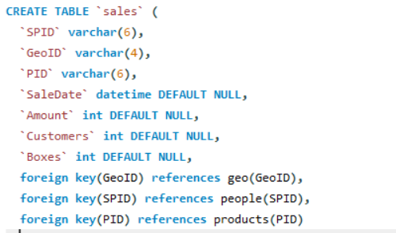
Database Structure
Description of the four main tables:
Geo: Contains geographic information.
People: Stores salesperson details.
Products: Lists product information.
Sales: Records sales transactions.
This tables are connected with foreign keys for efficient and robust database structure.

Slide 4
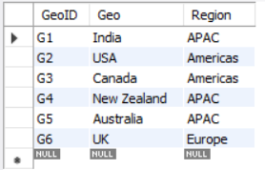

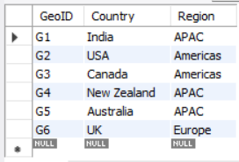
Ensuring Data Integrity: Column Modifications for clarity: Explanation: Renames "Geo" column to "Country" in the "geo" table.
Input
Output

Slide 5
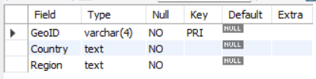

Modifying the Region column in the geo table to disallow NULL values, ensuring all records have valid data.
Input
Output

Slide 6
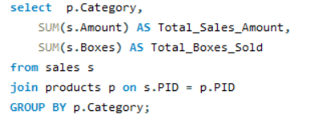
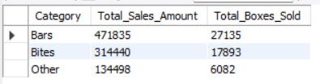
Aggregate Analysis of Sales and Boxes Sold by Product Category
Input
Output

Slide 7
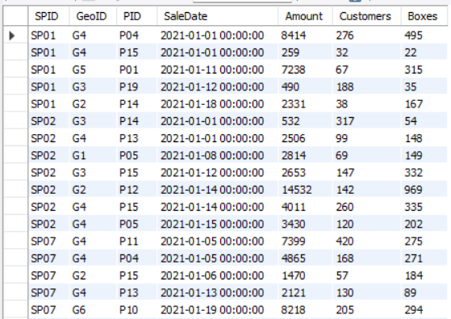

Targeted Analysis of Sales Records by Salesperson Explanation: Retrieves sales records for specified salespersons using the IN operator.
Input
Output

Slide 8
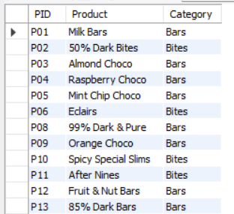

Filtering of CATEGORIES Products by USING NAMES WITH WILDcard OPERATOR: EXPLANATION: Retrieves PRODUCTS whose CATEGOTY names start with ‘B' using the LIKE operator.
Input
Output

Slide 9
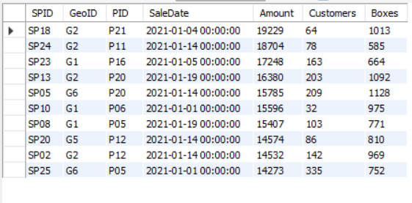
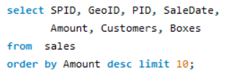
Identifying High-Value Sales Transactions Explanation:Retrieves the top 10 sales records ordered by amount using the LIMIT clause.
Input
Output

Slide 10
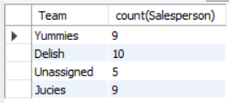

TOTAL Salesperson Count by Team: Explanation: This query calculates total number of salespersons in each team from the ‘people’ table
Input
Output

Slide 11
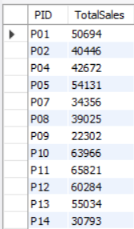

Identifying High-Performing Products by Sales Volume Explanation:Filters products with total sales greater than $20,000 using GROUP BY and HAVING clauses.
Input
Output

Slide 12
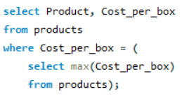

Finding the product with the highest cost per box. Explanation:query retrieves the record of product having highest cost_per_box
Input
Output

Slide 13
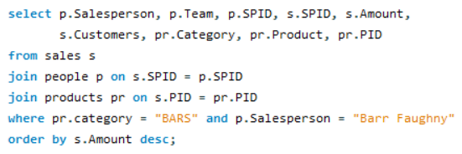
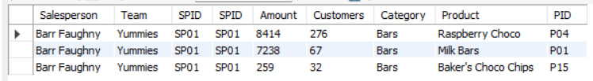
Retrieving sales records for the salesperson "Barr Faughny" in the "BARS" category, ordered by sales amount
Input
Output

Slide 14
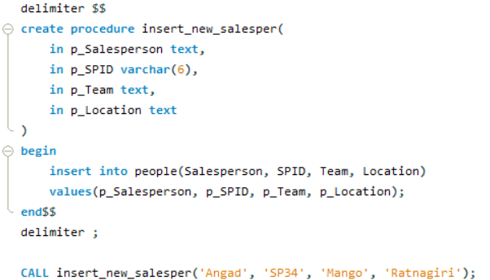
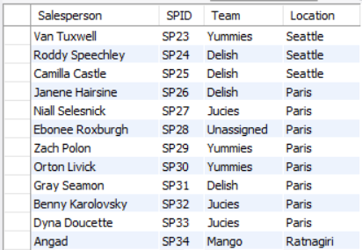
Streamlined Data Entry: Adding a New Salesperson via Stored Procedure Explanation: Creates a stored procedure to insert a new salesperson into the "people" table, enhancing data management efficiency.
Input
Output

Slide 15
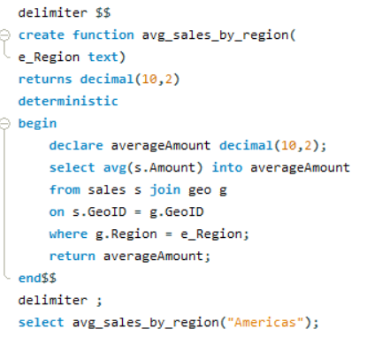
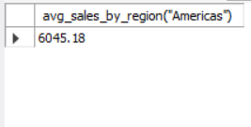
Efficient Data Analysis: Average Sales Calculation by Region by creating a stored function Explanation: Defines a function to calculate average sales for a given region, improving data analysis efficiency.
Input
Output

Slide 16
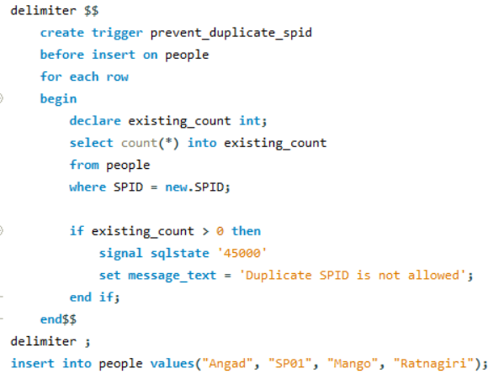

Ensuring Data Integrity: Trigger for Duplicate Salesperson ID Prevention Explanation: Creates a trigger to prevent duplicate salesperson IDs in the people table, ensuring data integrity during insertions.
Input
Output

Slide 17
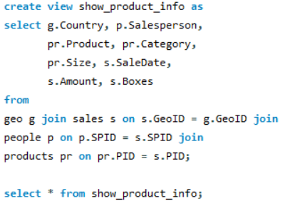
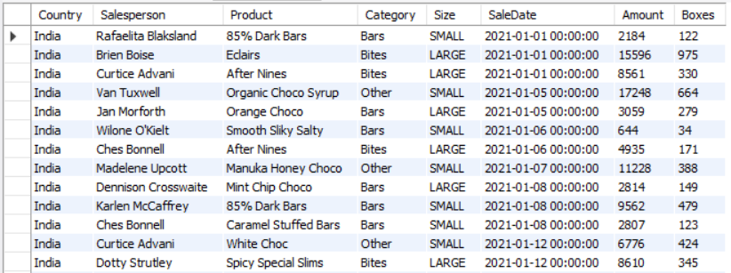
Comprehensive View of Products, Sales, and Geography Explanation: Creates a view to display detailed product and sales information, streamlining data retrieval for analysis.
Input
Output

Slide 18

Conclusion
In this project, I utilized SQL to manage and analyze sales data through key features such as joins for comprehensive reporting, stored procedures for inserting new salespersons, and functions to calculate average sales by region. Additionally, I implemented triggers to ensure data integrity by preventing duplicate entries. This approach demonstrated my ability to leverage database functionalities to drive informed business decisions and enhance operational efficiency.

Slide 19

Thank you

